Slide 1

Bank loan analytics
GROUP 3
Nandana Asish
Pukkala Mahendra
Santhosh B
Ankur R Bodhgire
Sakshi Sanjay Verma
Harsha Langote
Rahul Umesh H S

Slide 2
Summary
The report we have generated is using data cleaning, data exploration and manipulation of data, justifies the status of the loans and customers.
The report will trigger a deviation of loan amount or status for verified and non verified accounts.
And the bank gets to know about the revolving balance.
Through interactive visualizations and data-driven analysis, this dashboard empowers stakeholders to make informed decisions, optimize risk assessment strategies, and identify trends to enhance lending practices and maximize profitability.

Slide 3
KPI’s
Loan amount status by year
Verification status and amount
Loan amount by purpose
Revolving balance by grade and sub grade
Loan amount by home ownership
Loan status by month

Slide 4

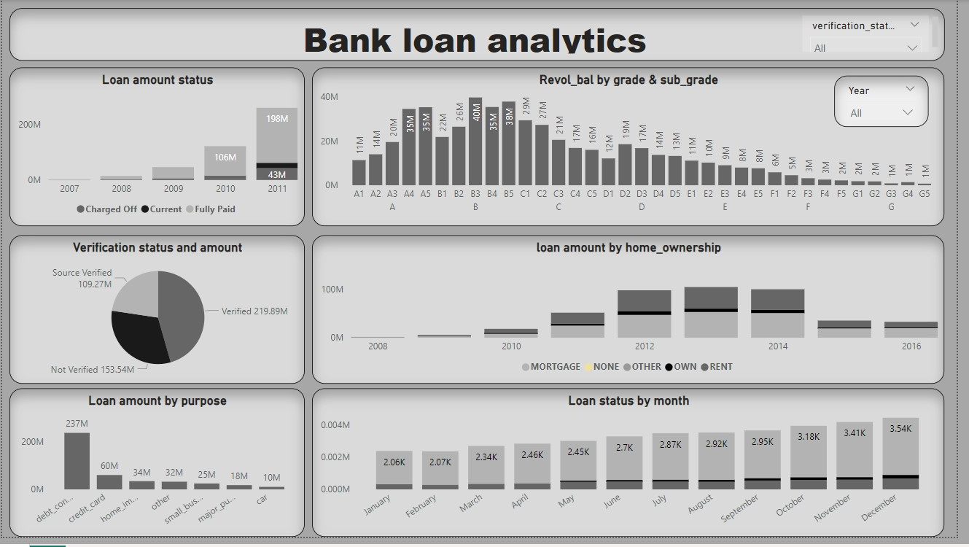
Power BI

Slide 5
Key Take Aways
Approval Rates: See how many loan applications get approved, helping understand the likelihood of getting a loan accepted.
Risk Trends: Identify patterns showing which loans are more likely to be paid back and which might have higher chances of defaulting.
Customer Profiles: Learn about the types of people applying for loans, like their age, income, and location, to tailor loan offerings better.
Portfolio Performance: Understand how the bank's overall loan portfolio is doing, whether it's growing, stagnant, or facing issues.
Impact of Factors: Discover how external factors like economic changes or interest rate fluctuations affect the loan processes, guiding future strategies

